Slide 1
HIV Viral load testing Overview
Norah Sukutayi Vere

Slide 2
Outline
HIV Viral Load scale up plan
Viral Load testing Labs distribution
HIV viral load testing capacity conventional machines
HIV testing performance 2018
HIV Testing Performance 2019
Challenges

Slide 3
Zimbabwe Viral Load Scale Up Plan
Revised Viral Load Testing Scale-Up Plan 2018-2020
Target for 2018 was to cover 60 % of ART cohort with a VL test.
Target for 2019 is to cover 80% of the ART Cohort with a VL test

Slide 4
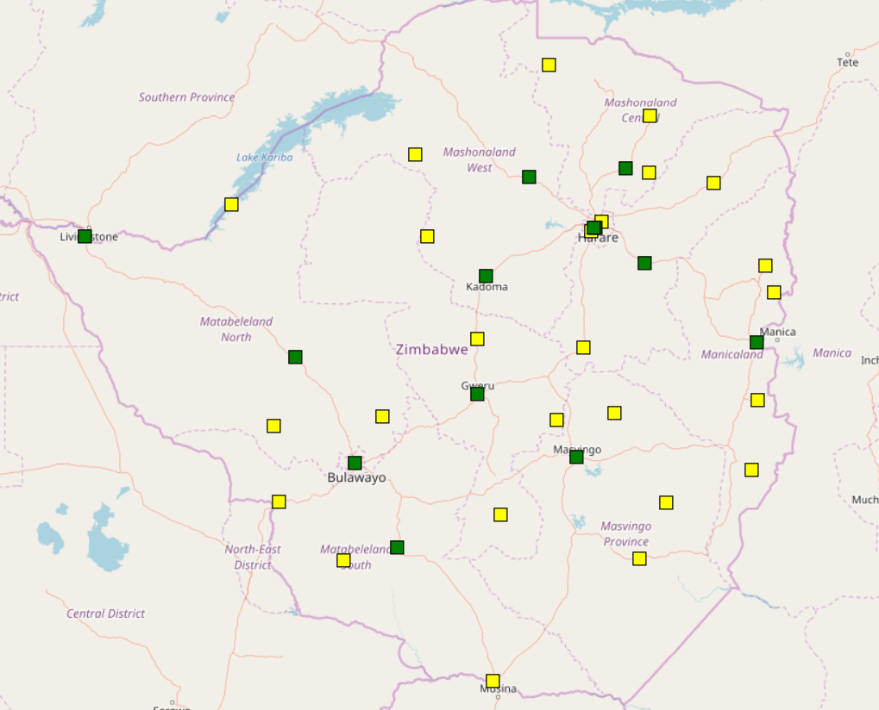
VL testing Laboratories
Zimbabwe started with targeted Viral load testing and moved towards universal coverage in 2016.
Started off with one testing lab and has expanded to 14 conventional and 25 POC sites between 2016 and 2018
Near POC TESTING SITES
CONVENTIONAL TESTING SITES

Slide 5
VL testing Lab | Instrument Type | Total number of instrument | Capacity/ instrument | Total capacity
Beat AIDS | Roche Cobas CAP/CTM96 | 1 | 44,352 | 44,352
Beatrice Road Infectious Disease Hospital | BM NucliSens Easy Q HIV-1 v 2.0 | 1 | 39,600 | 39,600
 | Roche Cobas CAP/CTM96 | 1 | 44,352 | 44,352
Chinhoyi Provincial | Roche Cobas CAP/CTM96 | 1 | 44,352 | 44,352
Chitungwiza (PSI) | Abbott m2000 | 1 | 31,680 | 31,680
Gweru Provincial Hospital | Roche Cobas CAP/CTM96 | 1 | 44,352 | 44,352
Masvingo Provincial Hosp. | Roche Cobas CAP/CTM 96 | 1 | 44,352 | 44,352
Mpilo Central Hospital | Roche Cobas CAP/CTM96 | 1 | 44,352 | 44,352
 | Abbott m2000 | 2 | 31,680 | 63,360
Mutare Provincial Hospital | Roche Cobas CAP/CTM96 | 1 | 44,352 | 44,352
 | Abbott m2000 | 2 | 31,680 | 63,360
NMRL | BM NucliSens Easy Q HIV-1 v 2.0 | 1 | 39,600 | 39,600
 | Abbott m2000 | 3 | 31,680 | 95,040
Gwanda and St. Luke’s Hospitals | Abbott m2000 | 2 | 31,680 | 63,360
Bindura, Kadoma, Marondera | Hologic Panther | 3 | 66000 | 198000
Various districts | Samba | 100 |  | 79200
Total Annual 8 hr capacity |  |  |  | 983,664

Slide 6
2018 VL quarterly test performance against scale up targets

Slide 7
2019 Quarterly VL against Scale up Targets

Slide 8
Challenges In Laboratories
Understaffing
Power interruptions- Working hours and capacity reduced because of power availability
Reagent and consumables stock outs
Suboptimal LIMS- challenges with data management and TAT

Slide 9
THANK YOU!

